Slide 1

WAY TO ENTERPRISE
React JS
VTI ACADEMY
Author: duy.nguyenngoc1@vti.com.vn
March 2020

Slide 2
Agenda
Web architecture
Setup Environment
HelloWorld program
Typescript
Assignments
Copyright © VTI Academy All Rights Reserved

Slide 3
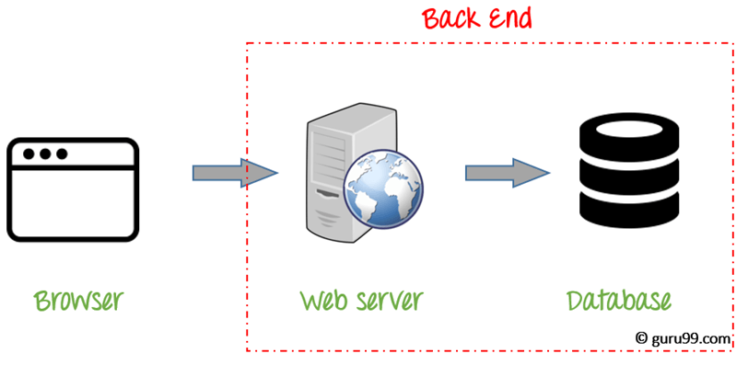
Web architecture

Slide 4
Setup Environment
See Setup slide

Slide 5
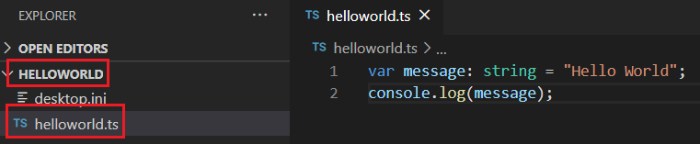
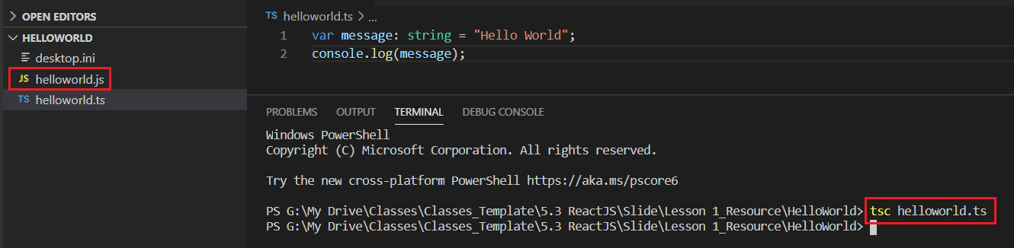
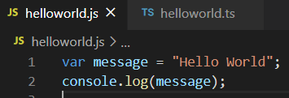
HelloWorld program
Step 1: Create helloworld.ts file
Step 2: compile ts file to js file

Slide 6
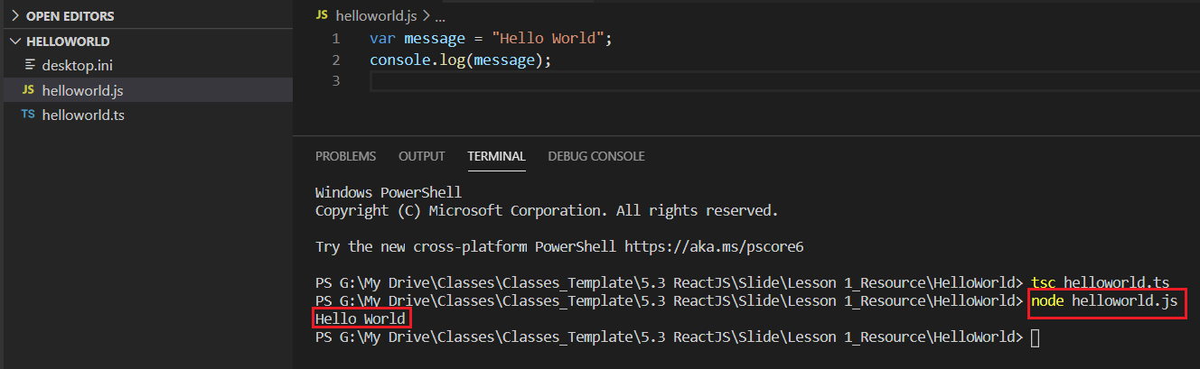
HelloWorld program
Step 3: Run js file

Slide 7
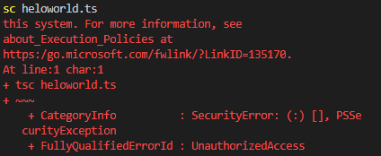
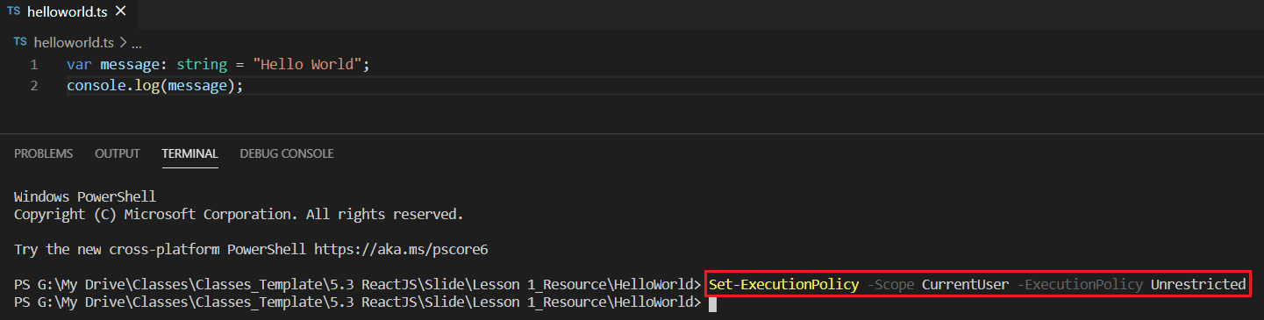
Fix error
Set-ExecutionPolicy -Scope CurrentUser -ExecutionPolicy Unrestricted

Slide 8
Testing System Assignments
Self-practice

Slide 9



TypeScript
A language for the client side (Angular 2, React JS) and server side (Node.js)
TypeScript is JavaScript for application-scale development.
Designed by Anders Hejlsberg (designer of C#) at Microsoft
Strongly typed, object oriented, compiled to JavaScript
Same strict mode + Javascript
Slower than Javascript

Slide 10
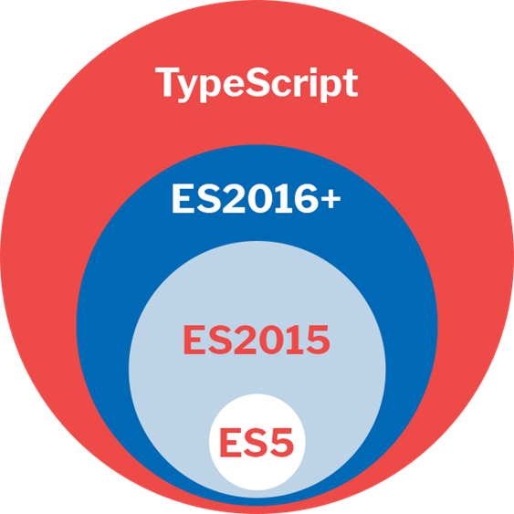
TypeScript

Slide 11
TypeScript
Datatype
OOP
Datatype Casting
Operators
Flow Control
Scope
Variables

Slide 12
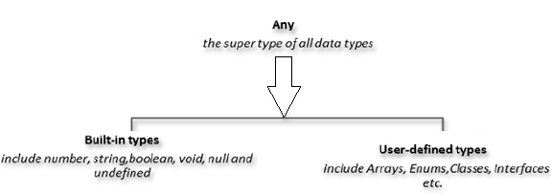
Datatype

Slide 13
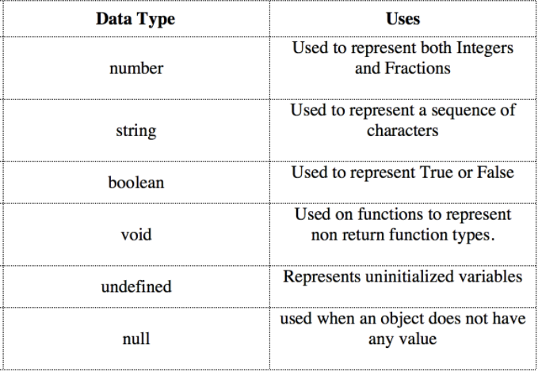
Built-in Types
Primitive

Slide 14
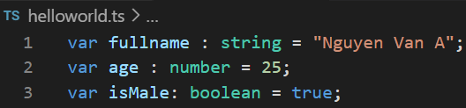
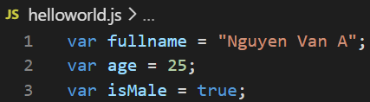
Example

Slide 15
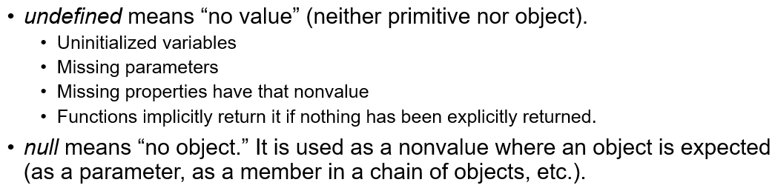
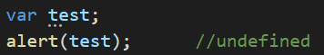
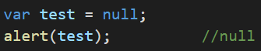
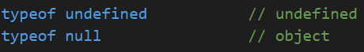
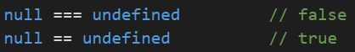
Null & Undefined

Slide 16
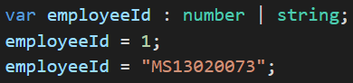
Union Datatype

Slide 17
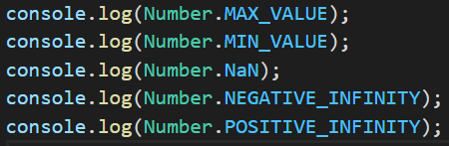
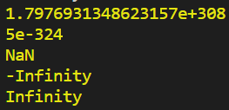
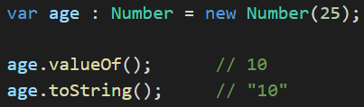
Wrapper class
Number
attribute: MAX_VALUE, MIN_VALUE, ...
Method: valueOf(), toString(), ...
https://www.tutorialspoint.com/typescript/typescript_numbers.htm

Slide 18
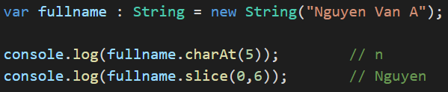
Wrapper class
String
attribute: length
method: charAt(), slice(), split(), ...
https://www.tutorialspoint.com/typescript/typescript_strings.htm

Slide 19
User-Defined Type
Object
Date
Array
Map
Set
Enum
Class

Slide 20
Date
https://www.javatpoint.com/typescript-date-object

Slide 21
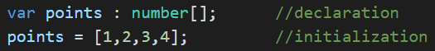
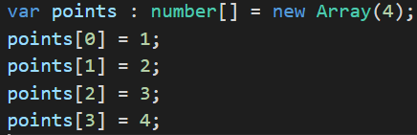
Array
Init
var name :datatype[] = new Array(n);
var name :Array<number>;
var name :datatype[] = new Array(val1, val2,...);
var name :datatype[] = [val1, val2,...];

Slide 22
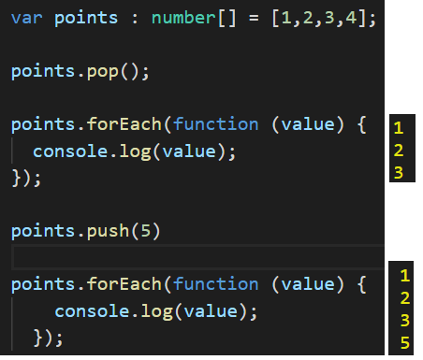
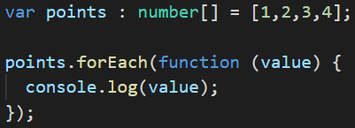
Array
Methods
forEach(), pop(), push(), reverse(), sort(), splice()
https://www.tutorialspoint.com/typescript/typescript_arrays.htm

Slide 23
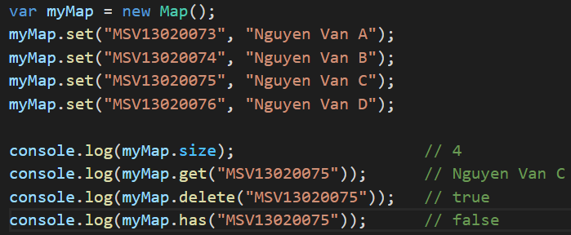
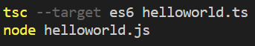
Map
Attribute: size
Methods: set(key, value), delete(key), has(key), clear()

Slide 24
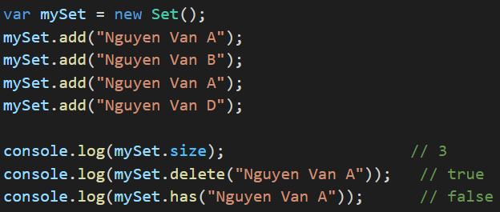
Set
Attribute: size
Methods: add(value), delete(value), has(value), clear()

Slide 25
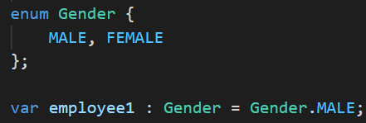
Enum
Init

Slide 26
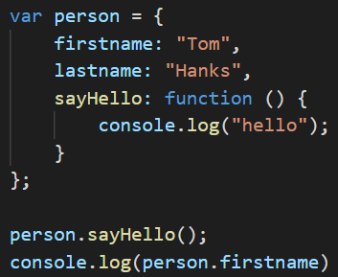
Object
Include:
property (key-value)
method

Slide 27
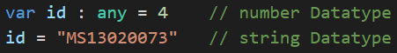
Any Type

Slide 28
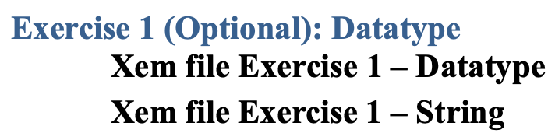
Testing System Assignments
Exercise 1 (Optional): Datatype

Slide 29
OOP
Class
Field / Method / Constructor
Getter / Setter
Access modifier
public (default) / private / protected
Nested class
Keyword
static
instanceof
typeof
Inheritance
Single Inheritance
Multilevel Inheritance
Multiple Inheritance
Override & Overload
Interface
Module

Slide 30
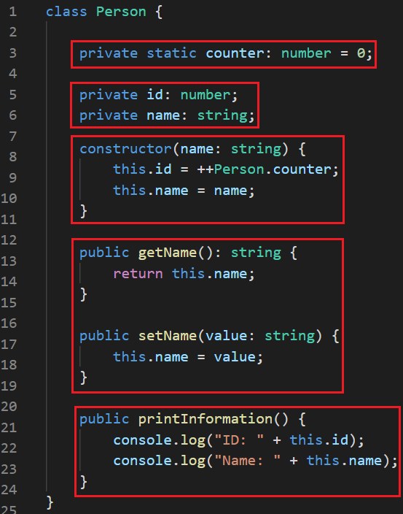
Class
Class
Field / Method
Constructor
Getter / Setter
Access modifier
public (default) / private / protected
static

Slide 31
Inheritance
Inheritance
Single Inheritance
Multilevel Inheritance
Multiple Inheritance
Override & Overload
Interface

Slide 32
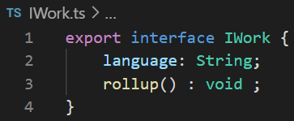
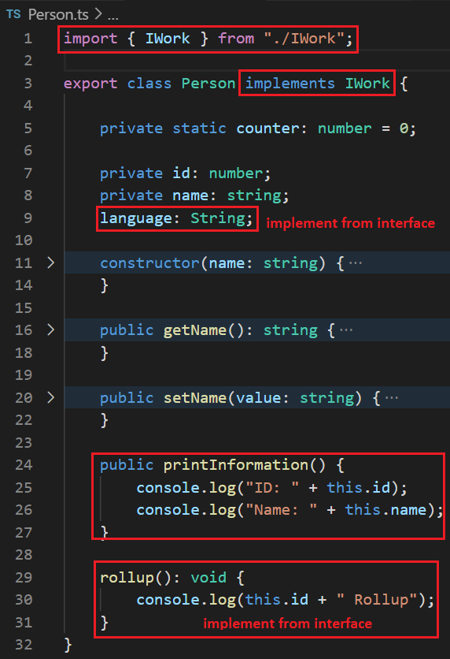
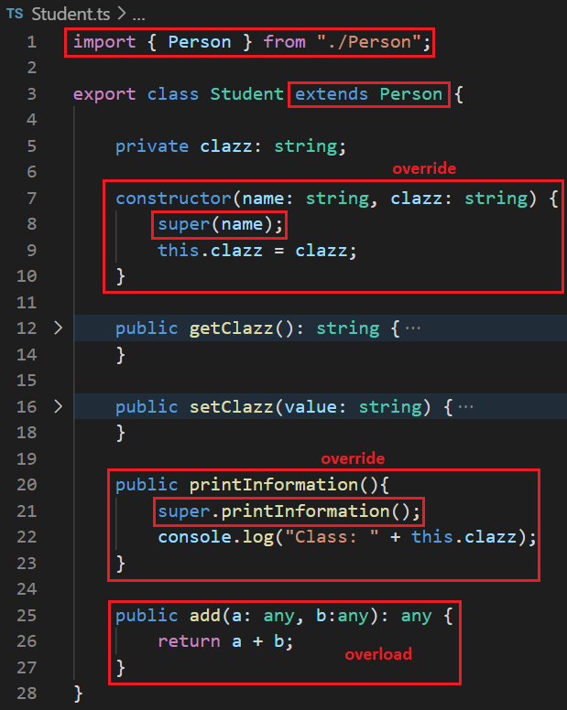
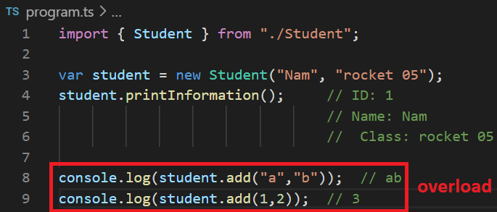
Inheritance

Slide 33
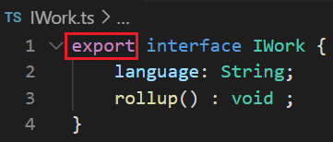
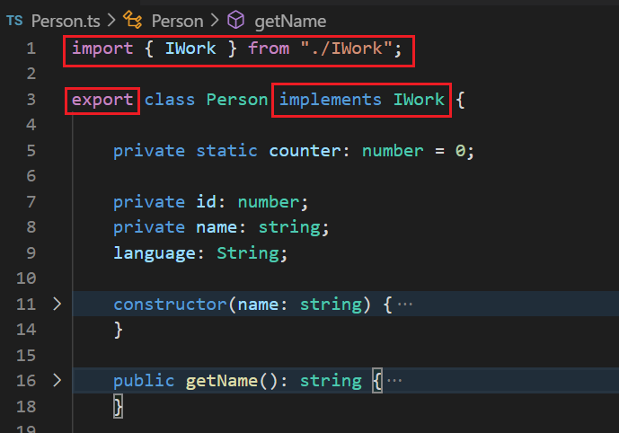
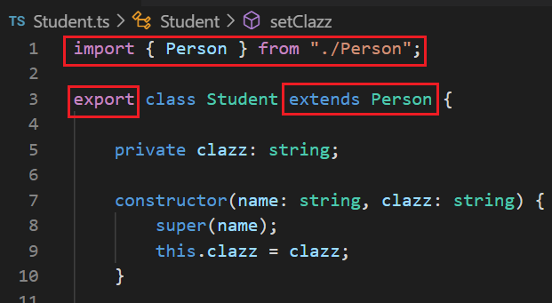
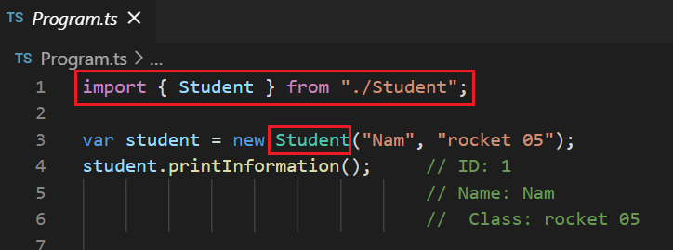
Module

Slide 34
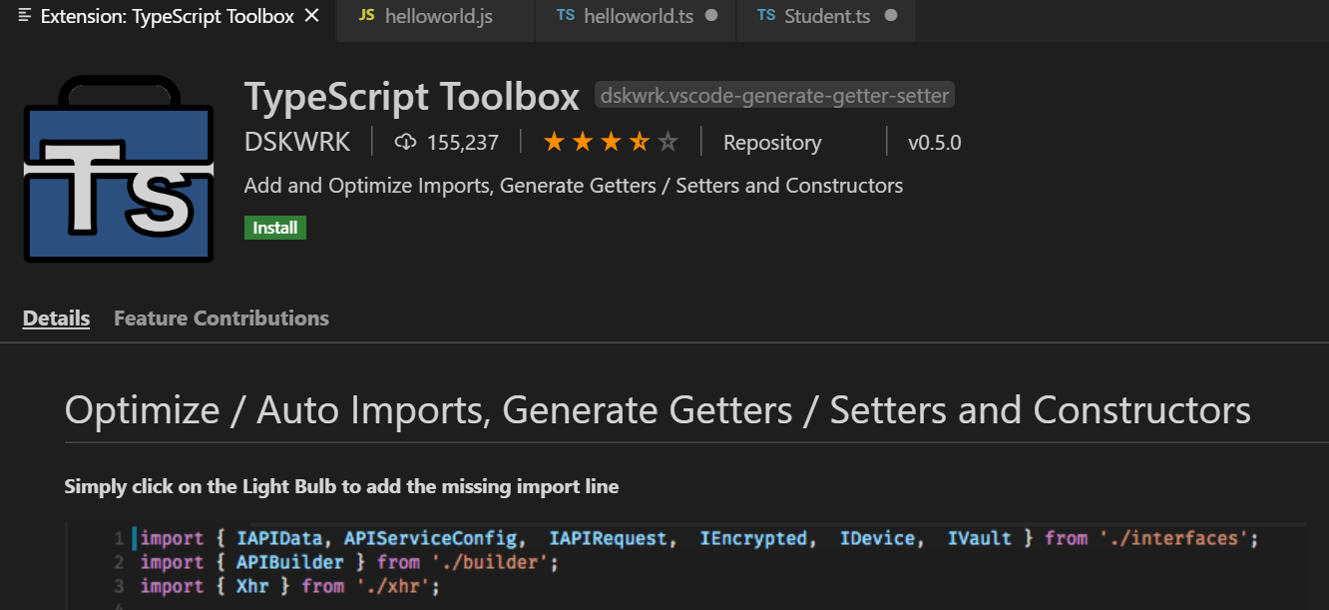
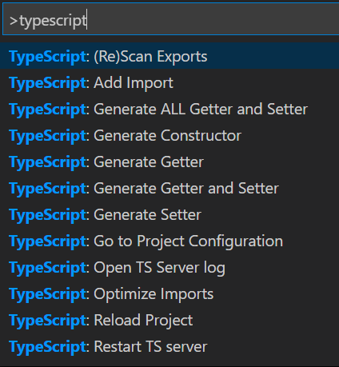
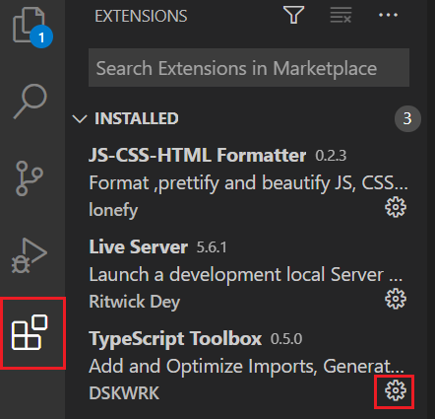
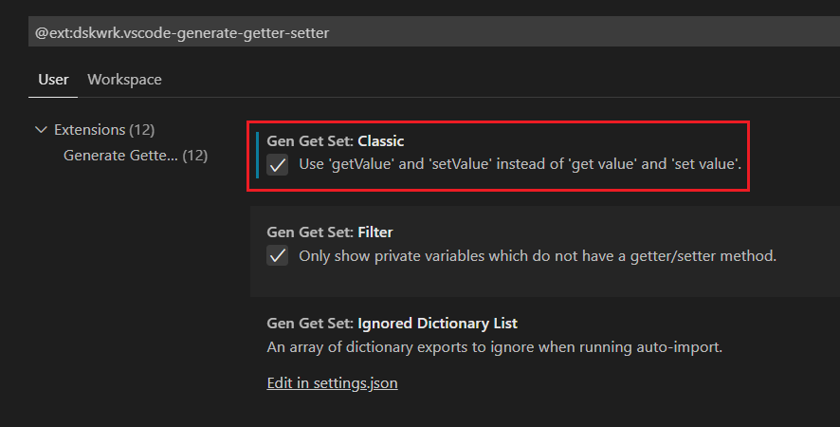
Shortcut
Shortcut: Ctrl+Shift+P
Setting Typescript Toolbox

Slide 35
Testing System Assignments
Self-practice

Slide 36
Generic
Class
Method
Extend

Slide 37
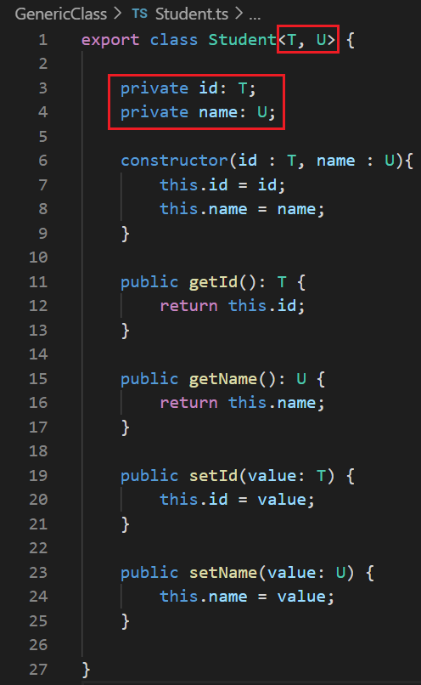
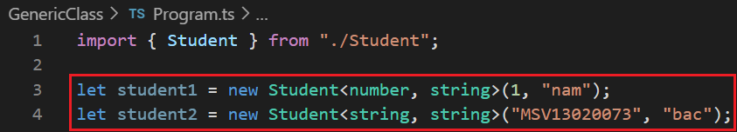
Generic
Generic class

Slide 38
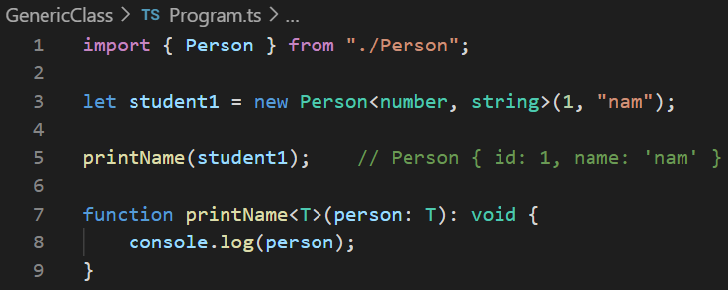
Generic
Generic method

Slide 39
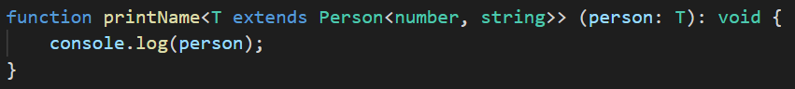
Generic
extends keyword

Slide 40
Testing System Assignments
Self-practice

Slide 41

Check Datatype
typeof

Slide 42


Datatype Casting

Slide 43

Testing System Assignments
Exercise 2 (Optional): Datatype Casting

Slide 44
Operators
Same JavaScript

Slide 45
Flow control
Same JavaScript

Slide 46




Flow control
for
for each
for of
for in
value
index

Slide 47

Testing System Assignments
Exercise 3 (Optional): Flow Control & Operator

Slide 48

Scope
3 scope types in Javascript
Global scope
Function scope (Local scope)
Lexical Scope (Static Scope)
Class, method, loop scope in Java
block scope

Slide 49



Global scope
Using both inside and outside the function
Hoisted (using variable before declaration)
Redeclare

Slide 50



Function scope (Local scope)
Cannot using outside the function
Hoisted (using variable before declaration)
Javascript has no loop scope (only function scope)

Slide 51


Lexical Scope (Static Scope)
scope chain
When finding the variable, Javascript will look from the smallest scope
scope3 🡺 scope2 🡺 scope1 🡺 global scope

Slide 52

Testing System Assignments
Exercise 4: Scope, Closure - Question 1

Slide 53

Reference Function

Slide 54


Closure
Closure is when a function is able to remember and access its lexical scope even when that function is executing outside its lexical scope).
Reference Function & Lexical Scope combination
Call getGreeting("Nguyen Van", "A") return only function

Slide 55


Closure & loop
Best practice: should not create function in loop (because there is no loop scope like java)
Example: print 1 2 3 4 5 every second
Error
Create a reference function to fix

Slide 56

Closure’s application
Function factory

Slide 57

Closure’s application
OOP simulation

Slide 58

Testing System Assignments
Exercise 4: Scope, Closure - Question 2, 3, 4, 5, 6

Slide 59

Variables
Syntax:
var [identifier] : [type-annotation] = value;
var [identifier] : [type-annotation];
var [identifier] = value;
var [identifier];

Slide 60
var & let & const
var (Not Recommend)
Global scope
Function scope (local scope)
global scope
local scope
redeclare

Slide 61


var & let & const
let
Block scope
Block scope

Slide 62



var & let & const
Cann’t redeclare
redeclare

Slide 63



var & let & const
const
stands for constant
block scope
primitive
Reference

Slide 64

Testing System Assignments
Exercise 5: Variable (var-let-const)

Slide 65

Testing System Assignments

Slide 66
Reference
https://www.javatpoint.com/typescript-tutorial
https://www.tutorialspoint.com/typescript/index.htm

Slide 67
Q & A
Copyright © VTI Academy All Rights Reserved

